Slide 1
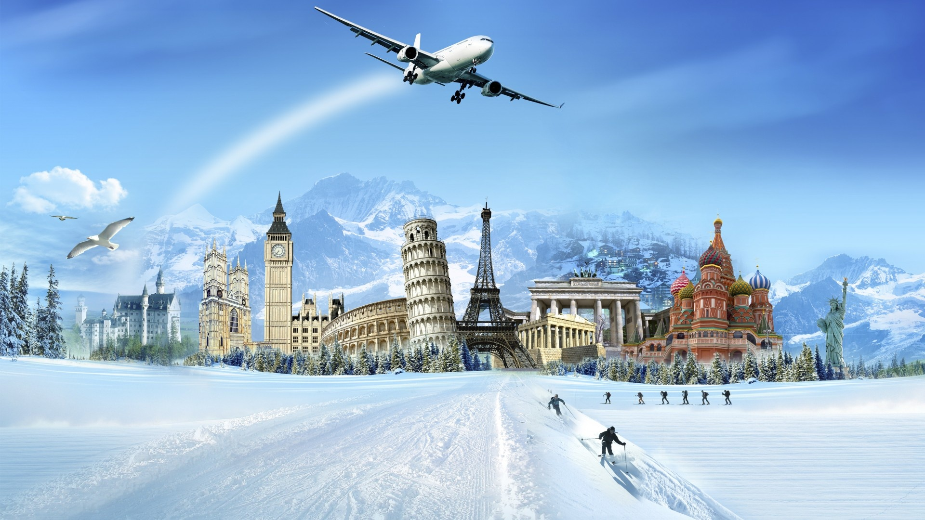
GoTravels
Team:
Yedla Prudvi Teja
Naveed Athaf
KADEMONI PRASANNA
Guide by:
RAJEEV KUMAR CHOUDHARY

Slide 2
Outline
Problem Statement
Objective
Microservices
Project Overview
Architecture
Application Flow
Technology and Tools Used
Conclusion

Slide 3

Problem Statement
GoTravels helps the travelers to find places and trips that match the most with their preferences , by providing the requirement of the traveler.
Safety is a major concern for people while planning holidays in recent times. As a developer we want to understand the behavior of the people trying to plan a holiday

Slide 4
Objective
Our objective is to make people aware of all up to date information about the travel time to time while planning for a trip.
Our objective is to provide the user the best experience while using the app.

Slide 5
About The Project
FRONTEND
BACKEND
The Front end part was done using angular
All the code is Written by using Bootstrap and Angular Material
It will consists the functionalities
Login & Register
Favorites
Directions
Places
The Backend part consists of Spring Boot
The Data like Registration , Login and Distance between two stations will be stored in database which are MySQL , MongoDB.

Slide 6
Project Overview

Slide 7
Microservices
User Authentication API
Favorite API
Directions API
Places API

Slide 8
Project Overview
User Authentication API
Favorite API
Directions API
Places API
Favorite
Login
Recommendation
Home
Directions
Register
SQL
Server
Mongo
Db
Mongo
Db
Mongo
Db
Places

Slide 9
Onboarding Architecture

Slide 10
Architecture
User Authentication API
JWT validator
SQL Server
Login/Register
POST request
Token generated
Favorite API
Add favorite
Delete favorite
POST /GET/
DELETE
Mongo Db
GET/DELETE
Front End
Angular
GET
Directions API
Get Directions
Mongo Db
GET
Places API
Mongo Db
GET
GET

Slide 11
Project Flow

Slide 12
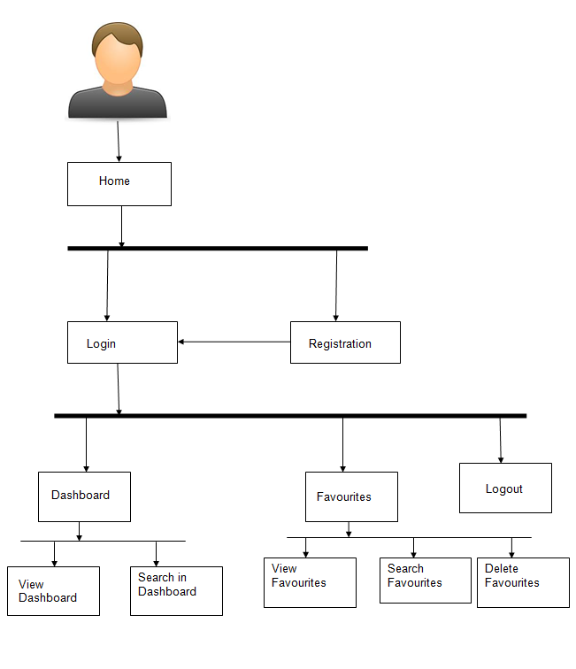
Project Flow
Home
Login
Register
Logout
Statistics
Profile
View Favourites
Places
Delete Profile
Edit Profile
Delete Favourite
Add to Favourite
Delete from Favourite

Slide 13









Technologies and Tools Used

Slide 14
Conclusion
The GoTravel app helps the user to get all the travelling statistics between two locations. It also helps user to store the favourite places and delete them afterwards.

Slide 15
Thank You

Slide 16


